Slide 1
OJEK ONLINE
Author:
-M. Hudya Ramadhana
-Radityo Harimurti
-Reza Maulana Ramadhan

Slide 2

Background

Slide 3
Data
15 Reports and Query
8 Tables

Slide 4
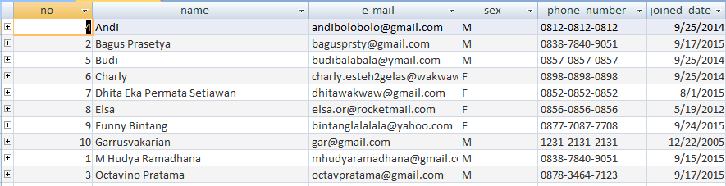
Database Design
User Details
Field Name | Data Type | Description
no | Autonumber | Number of the data
name | Text | User’s detail
email | Text | User’s E-mail
sex | Text | User’s gender
phone number | Text | User’s phone number
joined Date | Date/Time | Date in which the user signed up

Slide 5
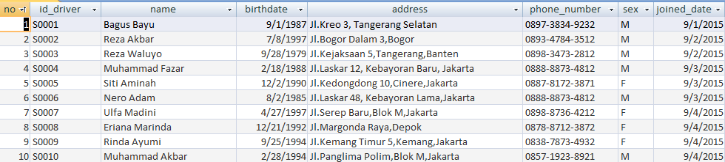
Driver Details
Field Name | Data Type | Description
no | Autonumber | Number of the data
Id_driver | Text | Driver’s id
name | Text | Driver’s name
birthdate | Date/Time | Driver’s birthdate
address | Text | Driver’s address
phone number | Text | Driver’s phone number
sex | Text | Driver’s gender
joined date | Date/Time | Date in which the driver signed up

Slide 6
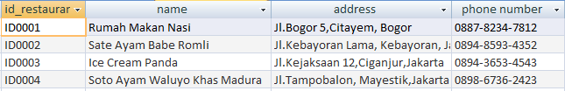
Restaurant Data
Field Name | Data Type | Description
Id_resturant | Text | Restaurant’s id
name | Text | Name of the restaurant
address | Text | Restaurant’s address
phone number | Text | Restaurant’s phone number

Slide 7
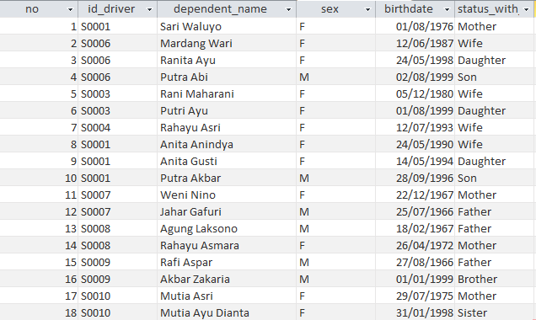
Driver dependent
Field Name | Data Type | Description
No | Autonumber | Number of the data
id_driver | Text | Driver’s id
dependent | Text | Dependent’s name
sex | Text | Staff’s gender
birthdate | Date/Time | Birthdate of the dependent
status with | Text | Dependent’s status with driver

Slide 8
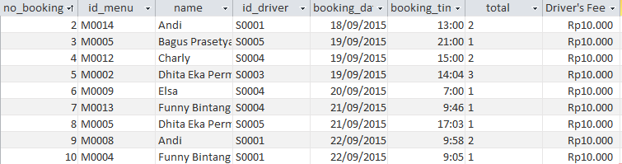
Food & Drink Transaction Details
Field Name | Data Type | Description
no_booking | Autonumber | Number of booking
id_menu | Text | Identification of the menu
name | Text | Name of the food/drink
id_driver | Text | Driver’s id
booking_date | Date/Time | Date of the booking
booking_time | Date/Time | Time of the booking
total | Text | Total of the items booked
Driver’s Fee | Number | Driver’s delivery fee

Slide 9
Courier Transport Transaction Table
Field Name | Data Type | Description
no_booking | Autonumber | Number of booking
types | Text | Types of service provided
id_staff | Text | Staff’s id
departure | Text | User Departure Location
destination | Text | User Destination Location
booking_time | Date/Time | Time of the booking
booking date | Date/Time | Date of the booking
fee | Number | Fee of the provided services

Slide 10
Feedback Table
Field Name | Data Type | Description
Name | Text | Name of User
E-mail | Text | User’s Email
Title | Text | Title of comment
Comment | Text | Comment field

Slide 11
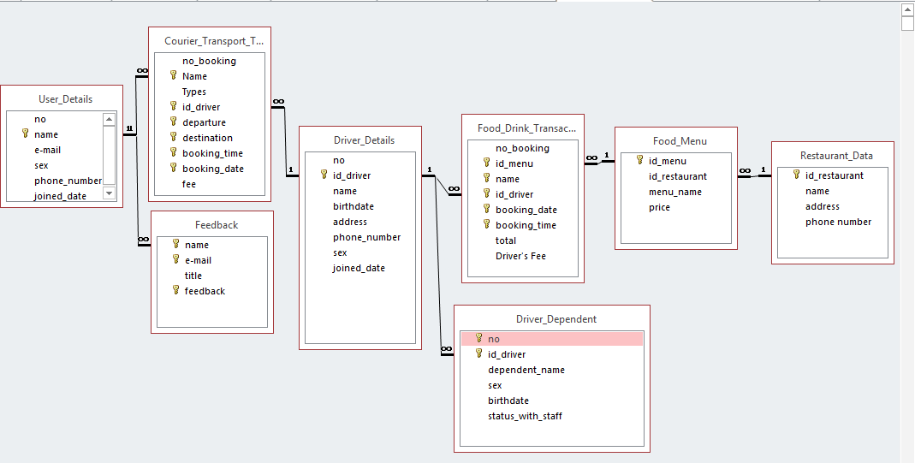
Relationship

Slide 12
Validations

Slide 13
Driver_Details
Name, Address, sex and phone number should not be left blank.
Phone_Number should be entered in the format, xxxx-xxxx-xxxx.
Sex must be written M or F
User_Details
Name, e-mail, sex, phone number should not be left blank.
Sex must be written M or F
Restaurant_data
ID_restaurant should start with ID and followed by 4 digit number
Phone_Number should be entered in the format, xxxx-xxxx-xxxx.

Slide 14
Food_Drink_Transaction
Id_menu,name,id_driver,Booking_date, booking_time,and total should not be left blank.
Courier_Transport_Transaction
Name,Types,id_driver,departure,destination,booking_time,and booking_date should not be left blank.
Food_Menu
Id_menu,id_restaurant,menu_name, and price should not be left blank.
ID_Menu should start with M and followed by 4 digit number
ID_restaurant should start iwht ID and followed by 4 digit number
Driver_Dependent
Id_driver, dependent name,sex, birthdate, and status_with_driver should not be left blank.
Sex must be written M or F

Slide 15
ALL QUERY AND FORM

Slide 16
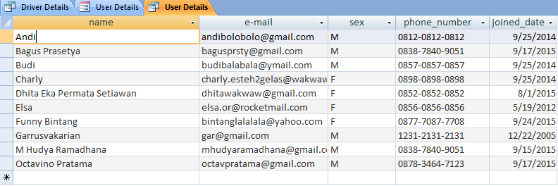
Query User Detail

Slide 17
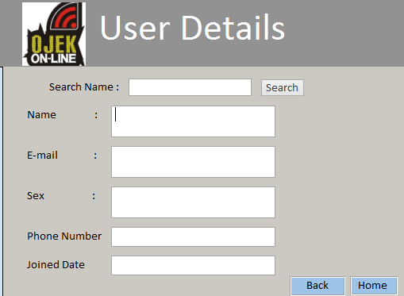
User Details Form

Slide 18
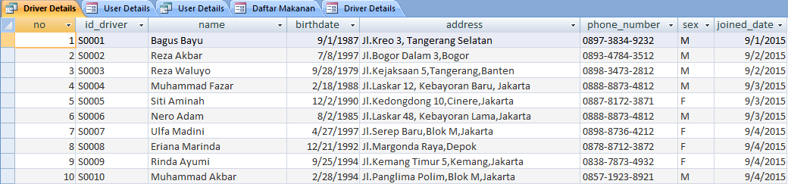
Query Driver Detail

Slide 19
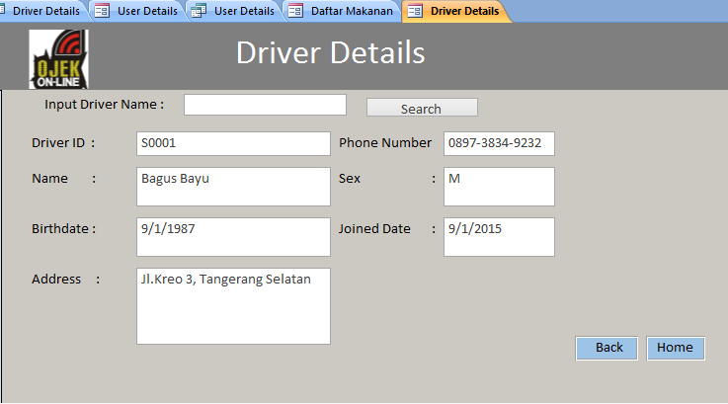
Driver Details Form

Slide 20
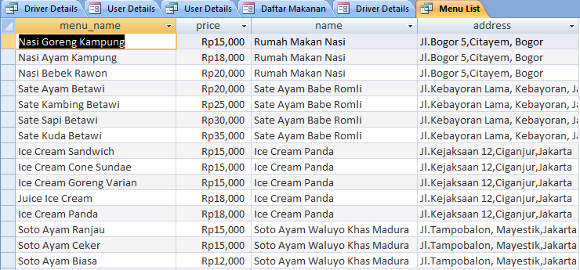
Menu List

Slide 21
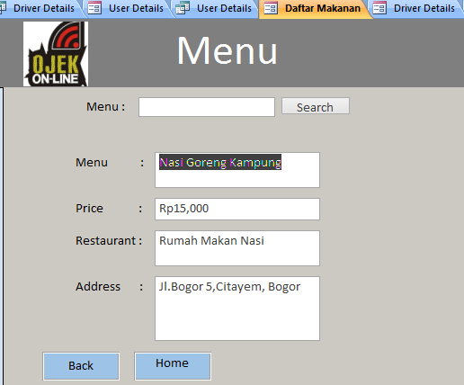
Menu List Form

Slide 22
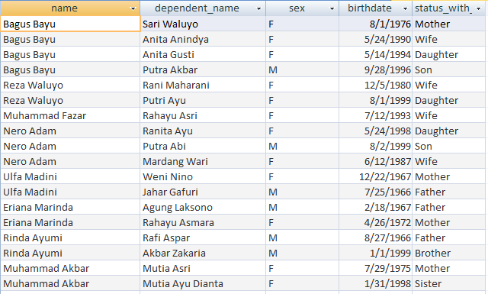
Query Driver Dependent

Slide 23
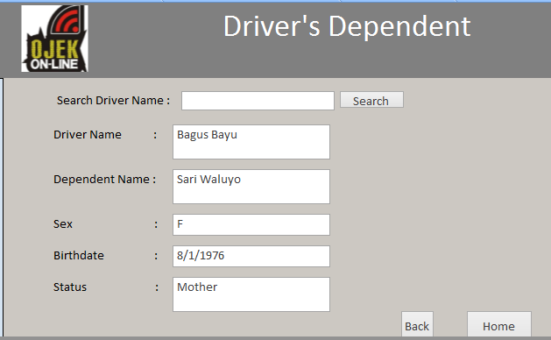
Driver Dependent Form

Slide 24
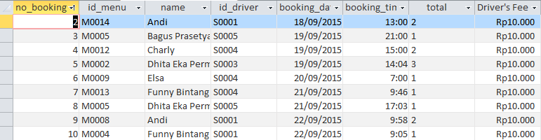
Query Food and Drink Transaction

Slide 25
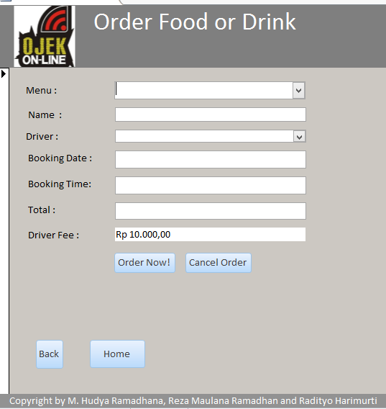
Food and Drink Transaction Form

Slide 26
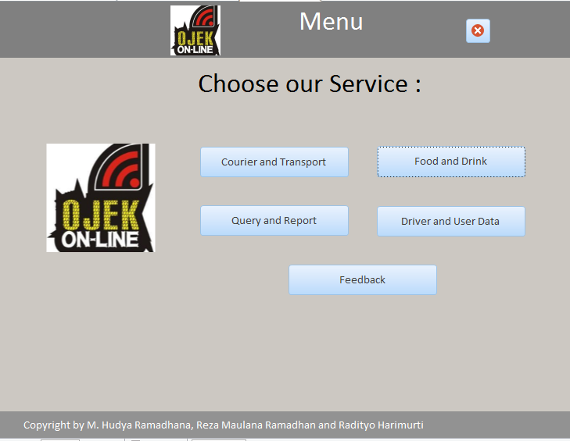
Home Form

Slide 27
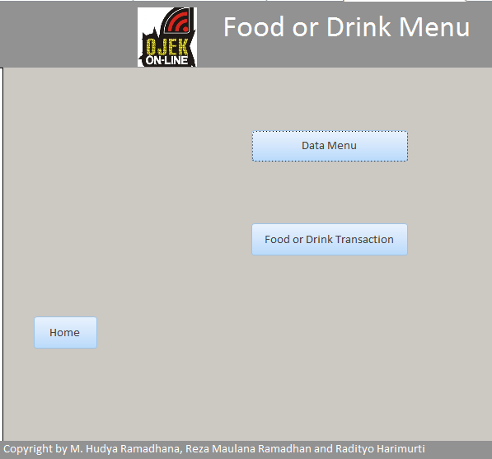
Food or Drink Menu

Slide 28
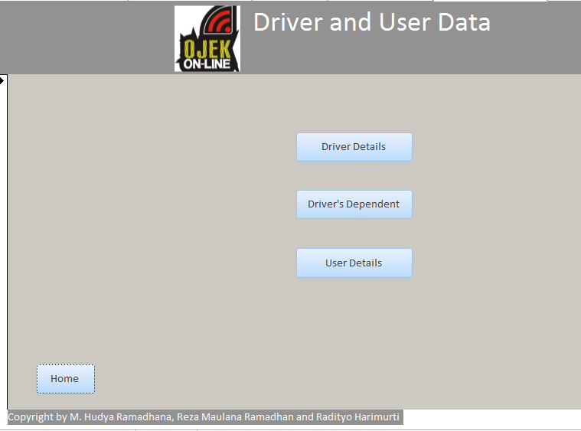
Driver and User Data Form

Slide 29
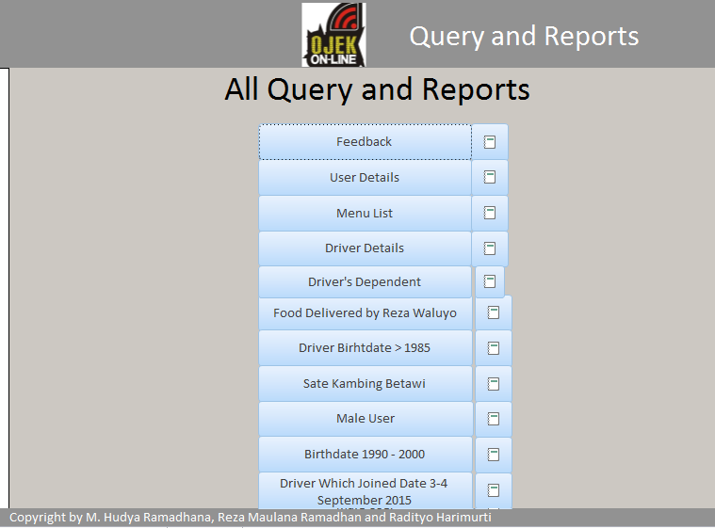
Query and Reports Form

Slide 30
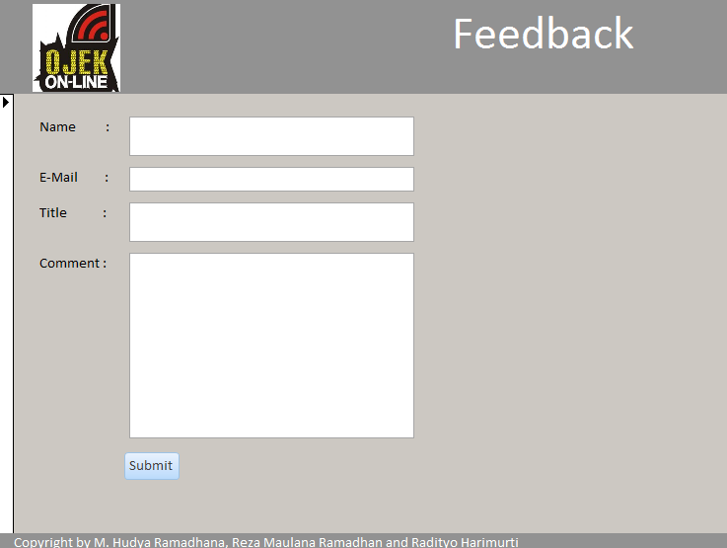
Feedback Form

Slide 31
CONCLUSION

